Slide 1

PRN292
Final Project Report
Sales management module
Team Gay
Supervisor | Mr. Phạm Ngọc Hà
Group members | Phạm Tùng Anh |  | SE06176
 | Nguyễn Gia Huy |  | SE05752
 | Hoàng Lê Thanh Sơn |  | SE05415
 | Vũ Hải Phong |  | SE05255
 | Nguyễn Thị Hồng Miên |  | SE05583
Project Code | SM

Slide 2
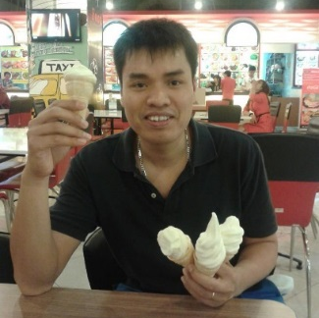
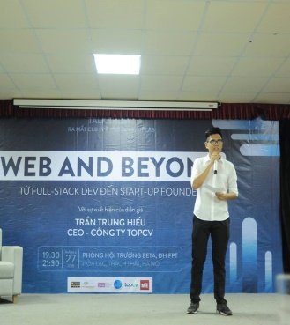




Members
Mr.HaPN
(Supervisor)
AnhPT
(Leader)
HuyNG
(Member)
PhongVH
(Member)
SonHLT
(Member)
MienNTH
(Member)

Slide 3
Table Of Contents
1. Introduction
2. Project management
3. Software Requirement Specification
4. Software Details Design
6. Lessons Learned
7. Demo
8. Q&A

Slide 4

1. Introduction
Fast shipping
Convenient ordering
Easy search
Easy pay

Slide 5
2. Project management
2.1. Software process model
2.2. Team organization
2.3. Project plan
2.4. Communication
2.5. Tools
2.6. Techniques
2.7. Risks & Issue management

Slide 6
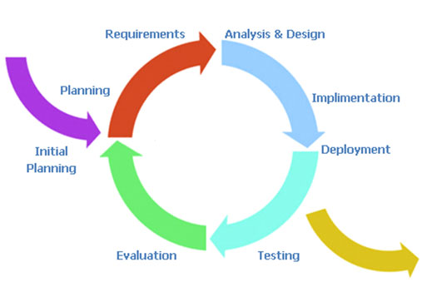
2. Project management
2.1. Software process model.
（Iterative Process Model）

Slide 7
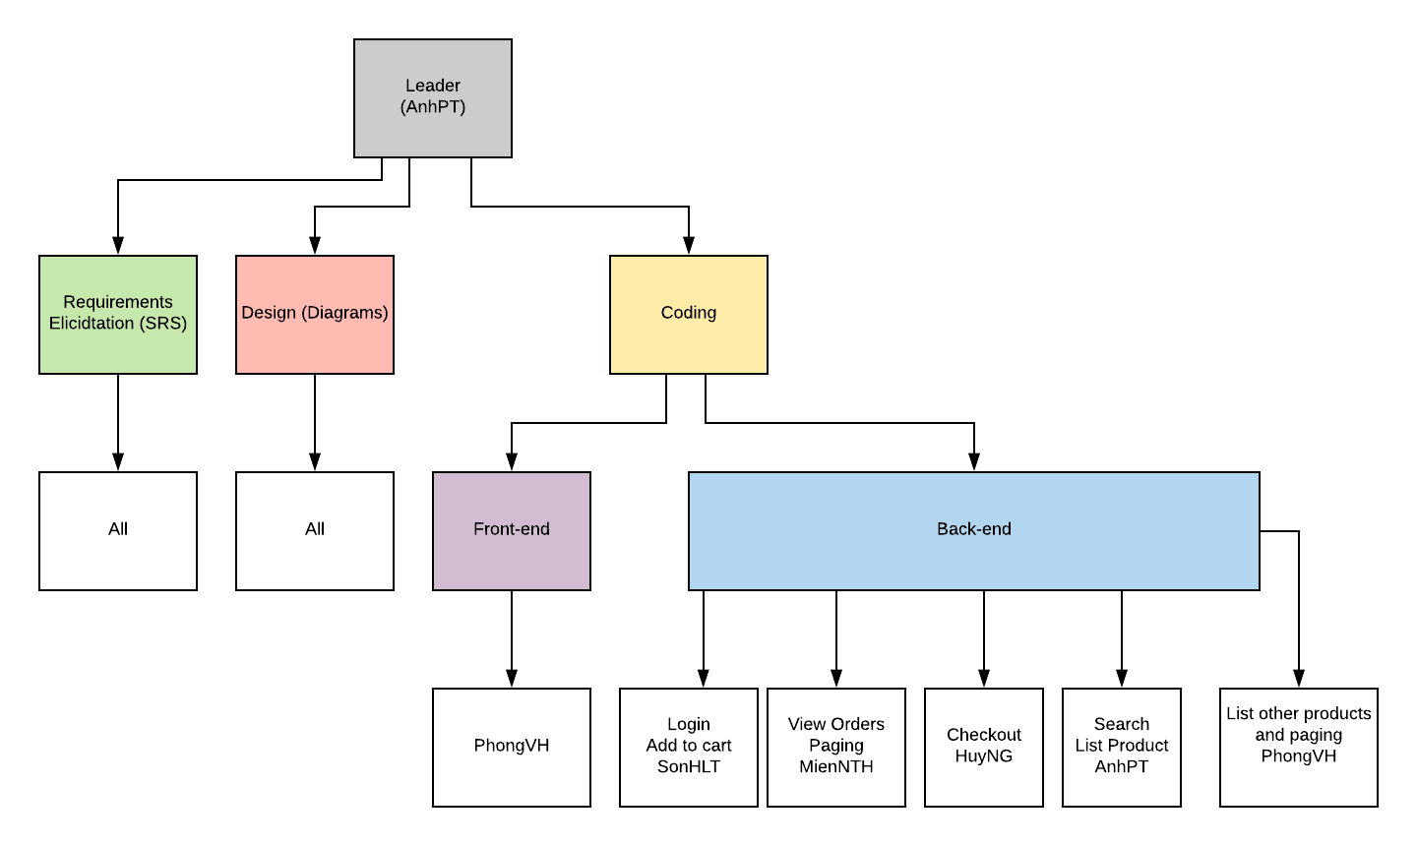
2. Project management

Slide 8






2. Project management
2.4. Tools
Word
Github
Visual Studio 2017
Lucid Chart
Powerpoint
Google Chrome

Slide 9






2. Project management
2.5. Techniques
Framework 4.5
SQLServer 2017
C#
CSS (Interface)
Javascript
HTML5

Slide 10


2. Project management
2.6. Communication
Time: bootcamp 3 consecutive evenings and OT at night individually
Location: school, home

Slide 11
3. Software Requirement Specification.
3.1. User requirement
3.2. System Requirement
3.3. Non-Functional Requirement

Slide 12


3. Software Requirement Specification.
3.1. User requirement.
There are 2 actors:
Shopper
Administrator

Slide 13
3. Software Requirement Specification.
3.1. User requirement.
Shopper
Be able to view all products and related information and add to cart easily
Be able to choose to pay online or offline (after the product is delivered to them)
Login and log out
Get information about their orders and shipping status

Slide 14
3. Software Requirement Specification.
3.1. User requirement.
Administrator
View orders
Update payment status

Slide 15
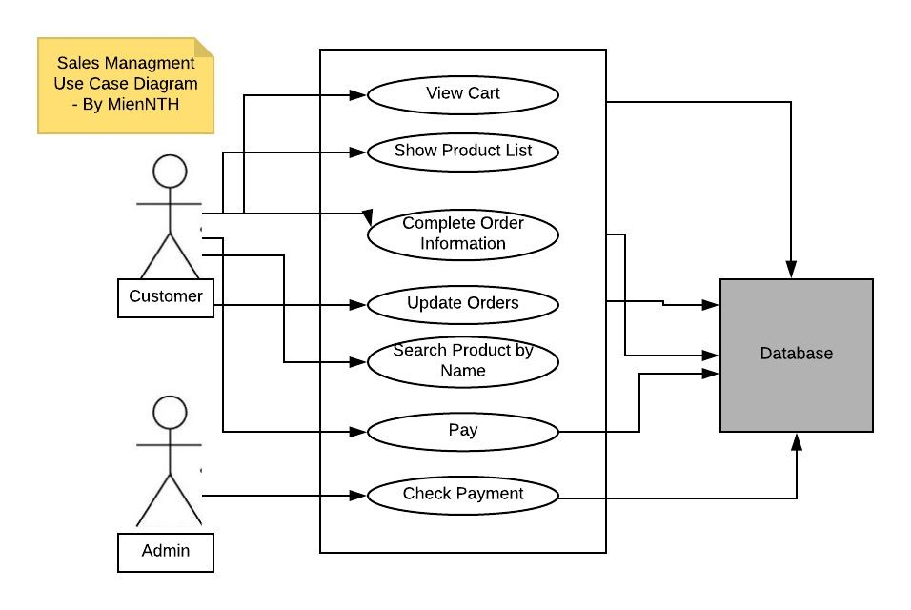
3. Software Requirement Specification.
3.1. System requirement.
Use Case Diagram

Slide 16
3. Software Requirement Specification.
3.2. System Requirement
User Interface
Simple and easy to use
Big menu name
Links and buttons are clickable

Slide 17



3. Software Requirement Specification.
3.2. System Requirement
Hardware Interfaces
- Computer (1 GB Ram, 100 GB on hard disk)
Processor: Intel core i5
Internet connection.

Slide 18
3. Software Requirement Specification.
3.3. Non-Functional Requirement
Usability
Reliability
Performance
Security

Slide 19
4. Software Details Design
4.1. Overall Architecture Design
4.2. 3-Tiers Model
4.3. Database Design
4.4. Screen flow (Dialog map)
4.5. Class Diagram
4.6. Sequence Diagram

Slide 20
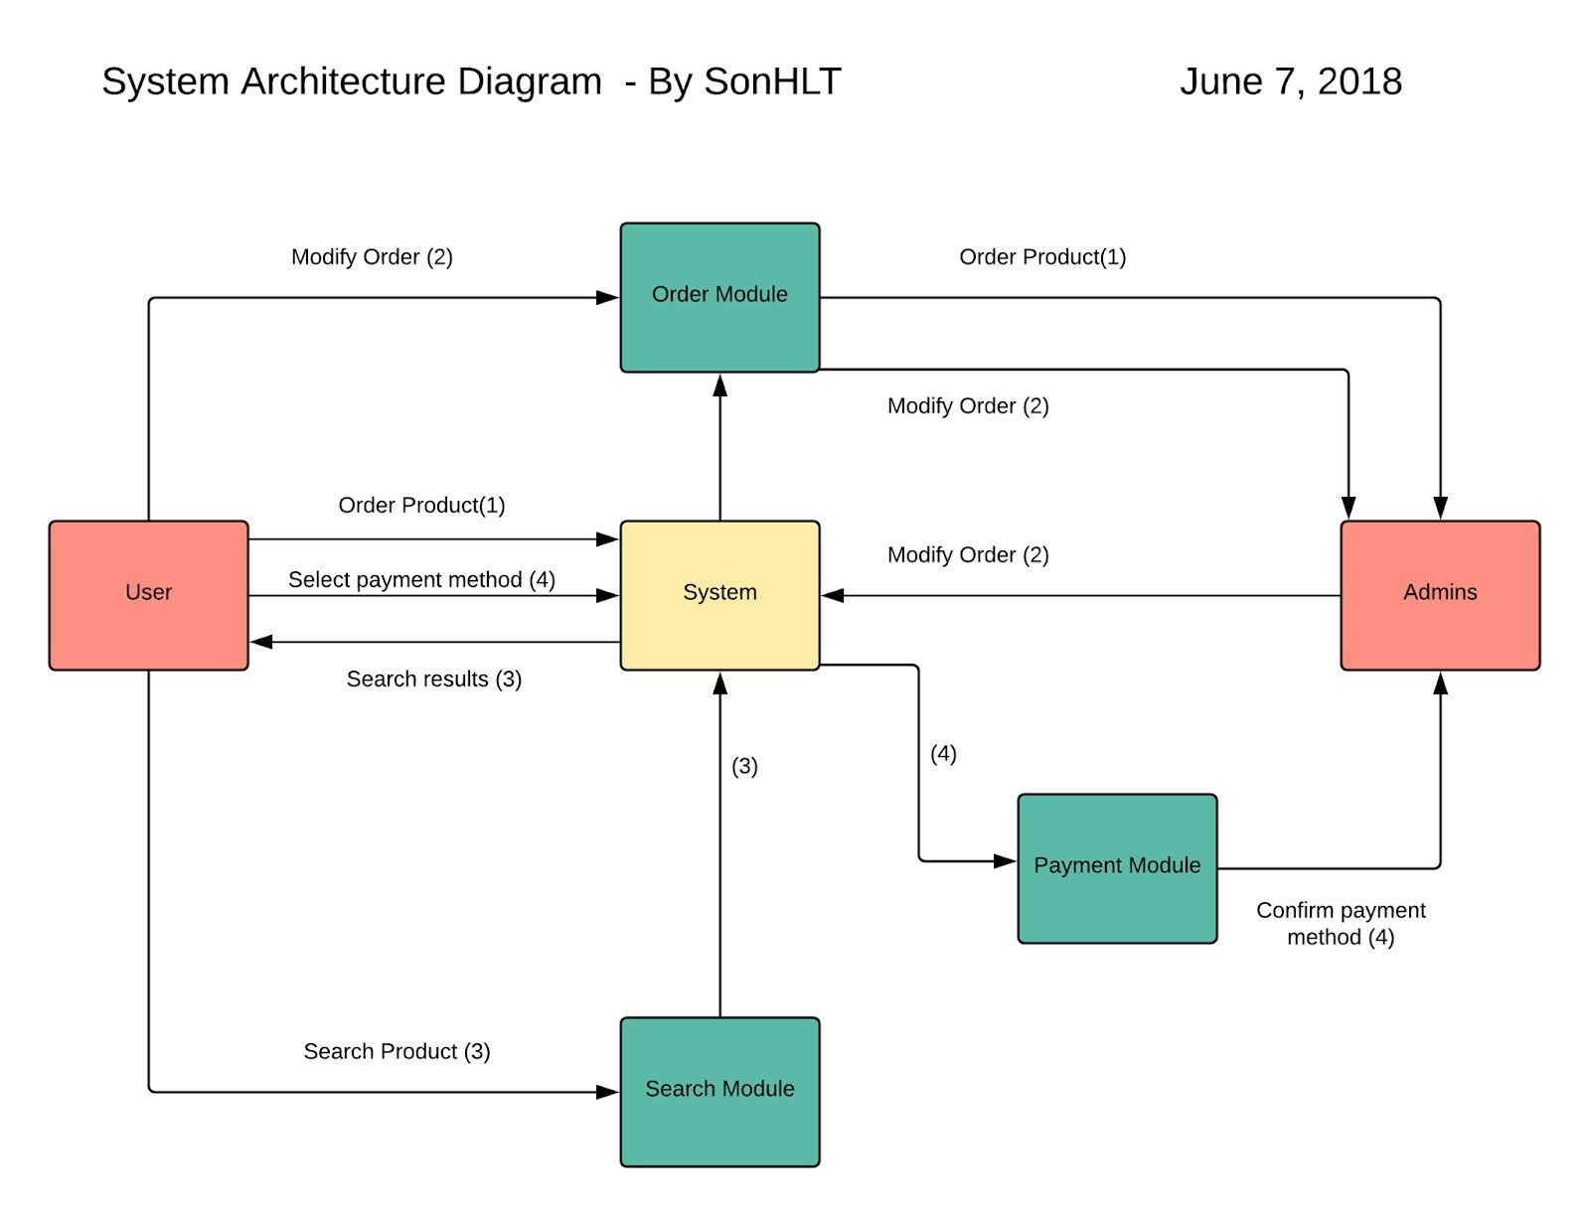
4. Software Details Design
4.1. Overall Architecture Design

Slide 21
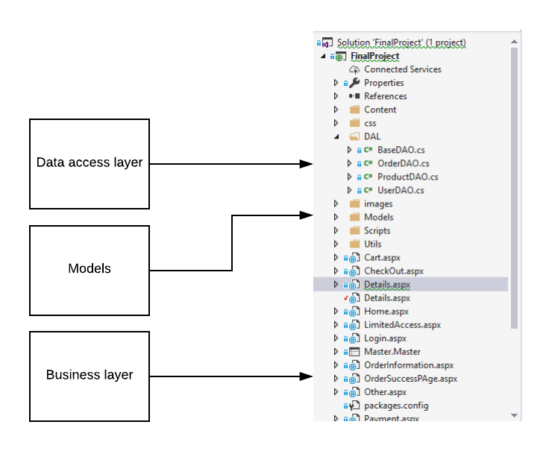
4. Software Details Design
4.2. 3-Tiers Model

Slide 22
4. Software Details Design
4.3. Database Design

Slide 23
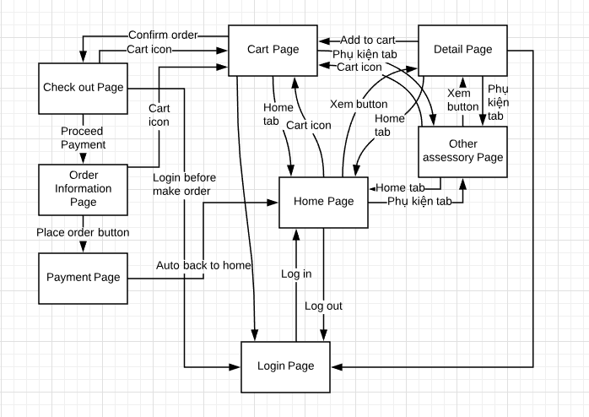
4. Software Details Design
4.4. Screen flow

Slide 24
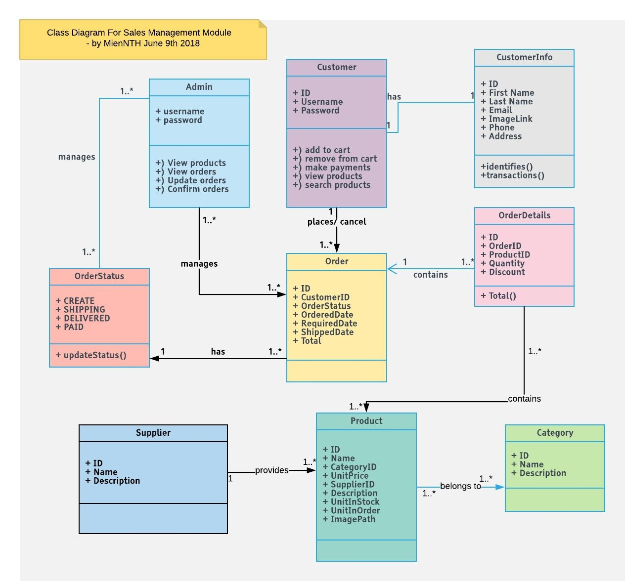
4. Software Details Design
4.5. Class Diagram

Slide 25
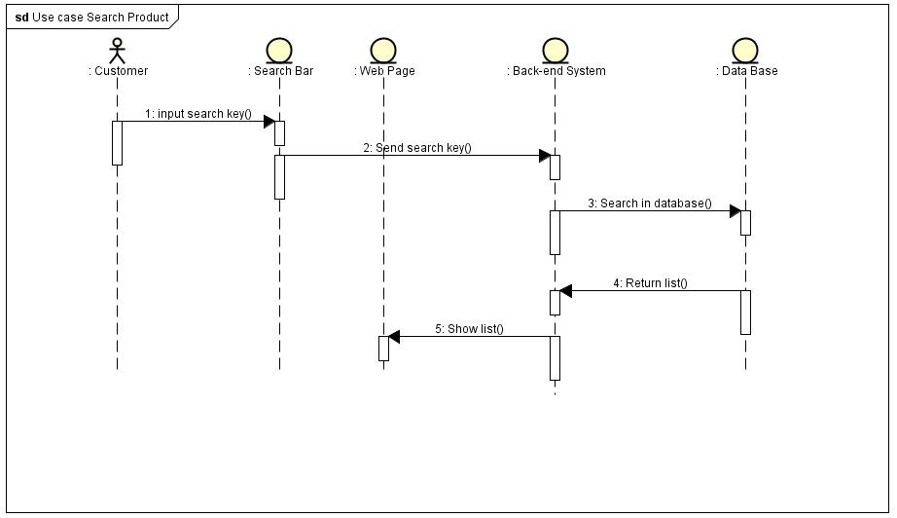
4. Software Details Design
4.6. Sequence Diagram
UC1

Slide 26
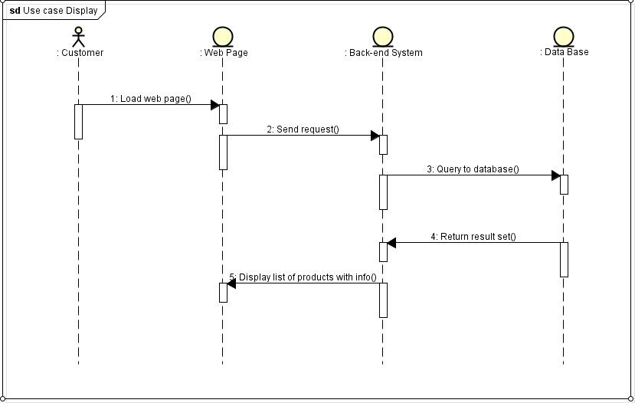
4. Software Details Design
4.6. Sequence Diagram
UC2

Slide 27
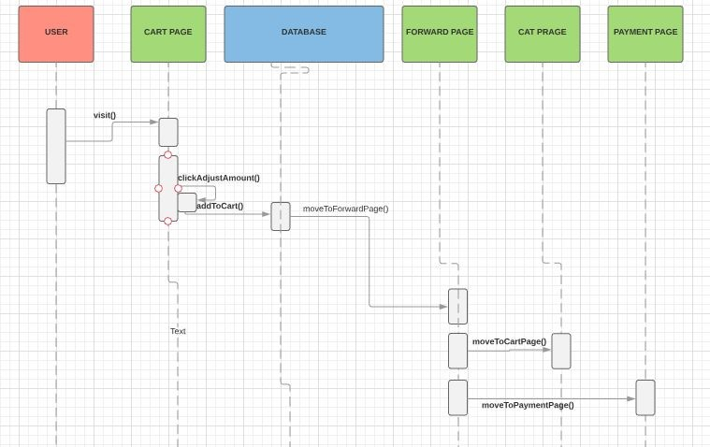
4. Software Details Design
4.6. Sequence Diagram
UC3

Slide 28
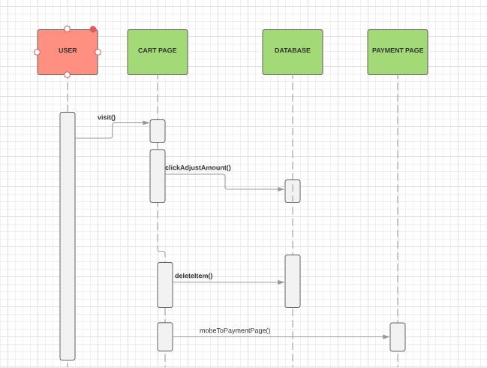
4. Software Details Design
4.6. Sequence Diagram
UC4

Slide 29
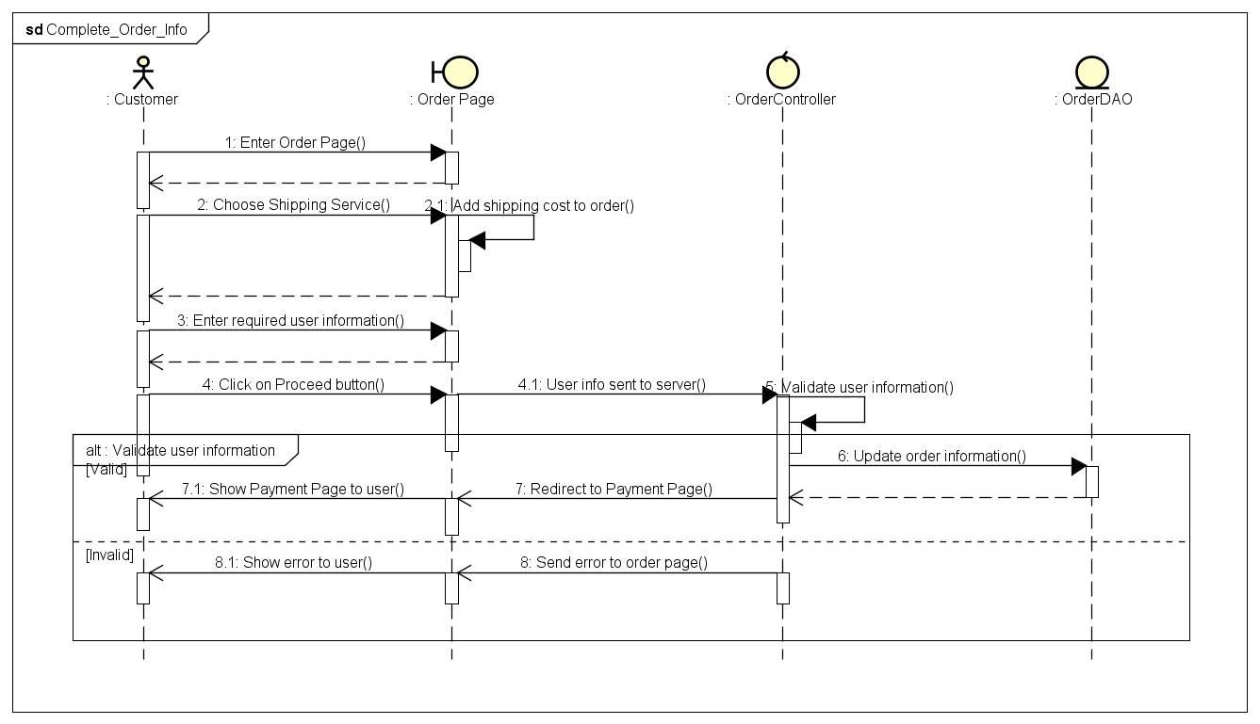
4. Software Details Design
4.6. Sequence Diagram
UC5

Slide 30
4. Software Details Design
4.6. Sequence Diagram
UC6

Slide 31
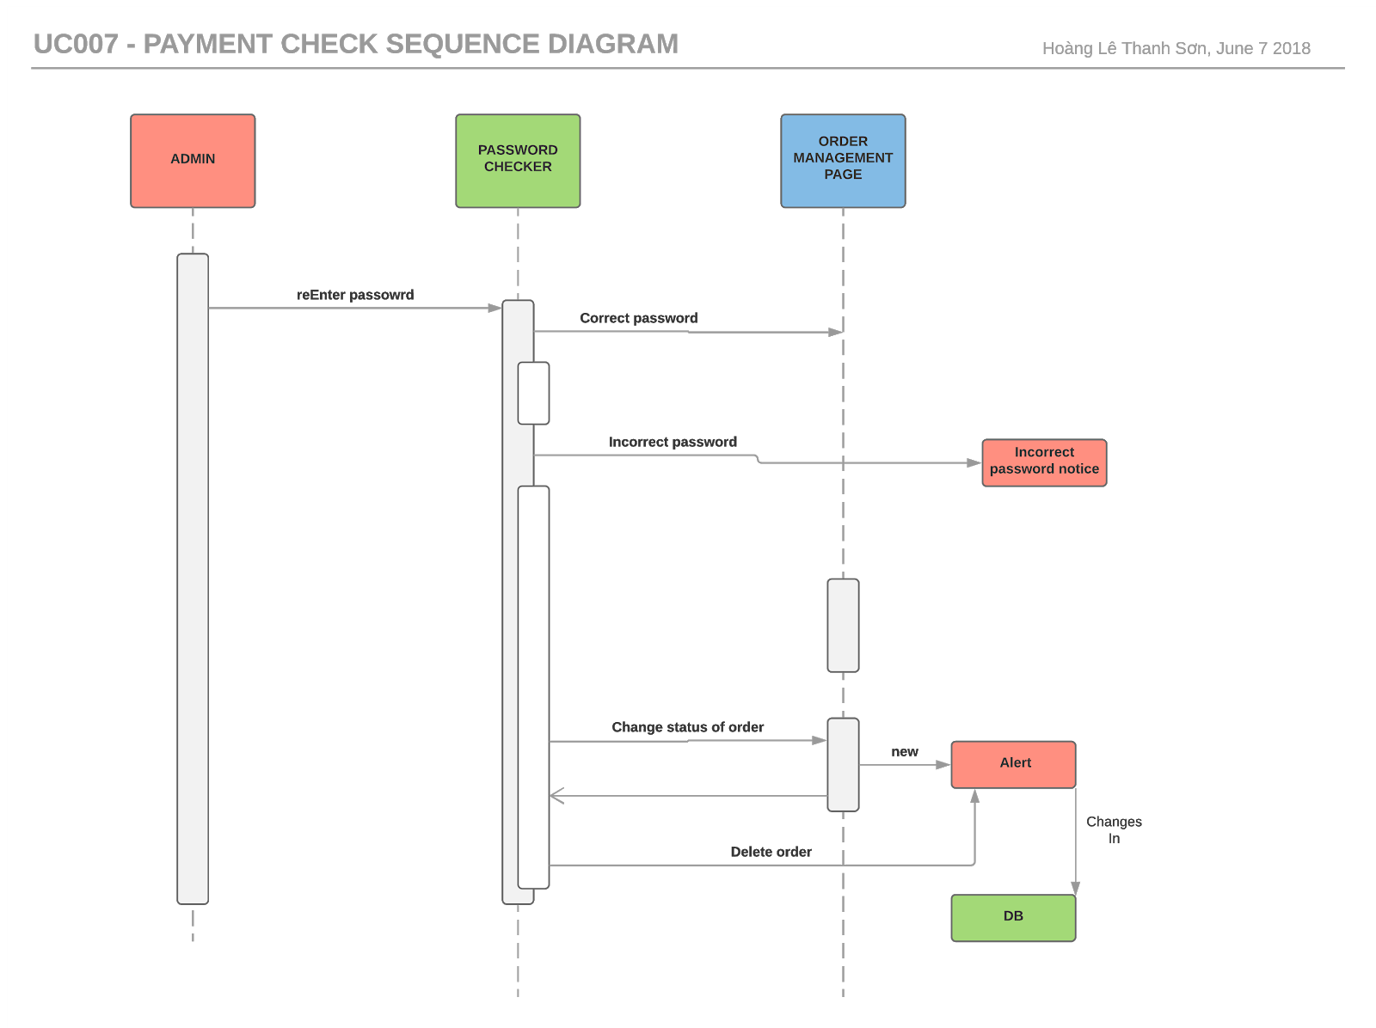
4. Software Details Design
4.6. Sequence Diagram
UC7

Slide 32
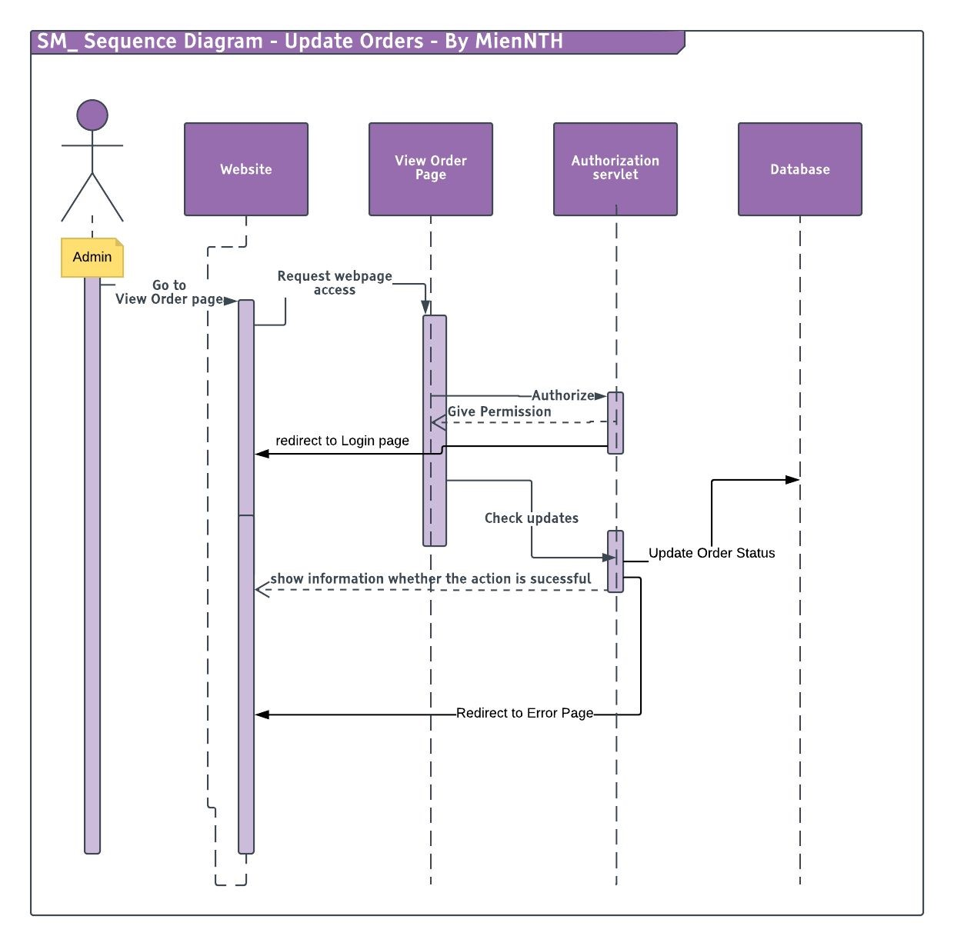
4. Software Details Design
4.6. Sequence Diagram
UC8

Slide 33

5. Lessons learned
- Software skills: Working in group, be elegant, time management
- Coding skills: .aspx web forms, C#.Net coding skills
- Others: Github

Slide 34
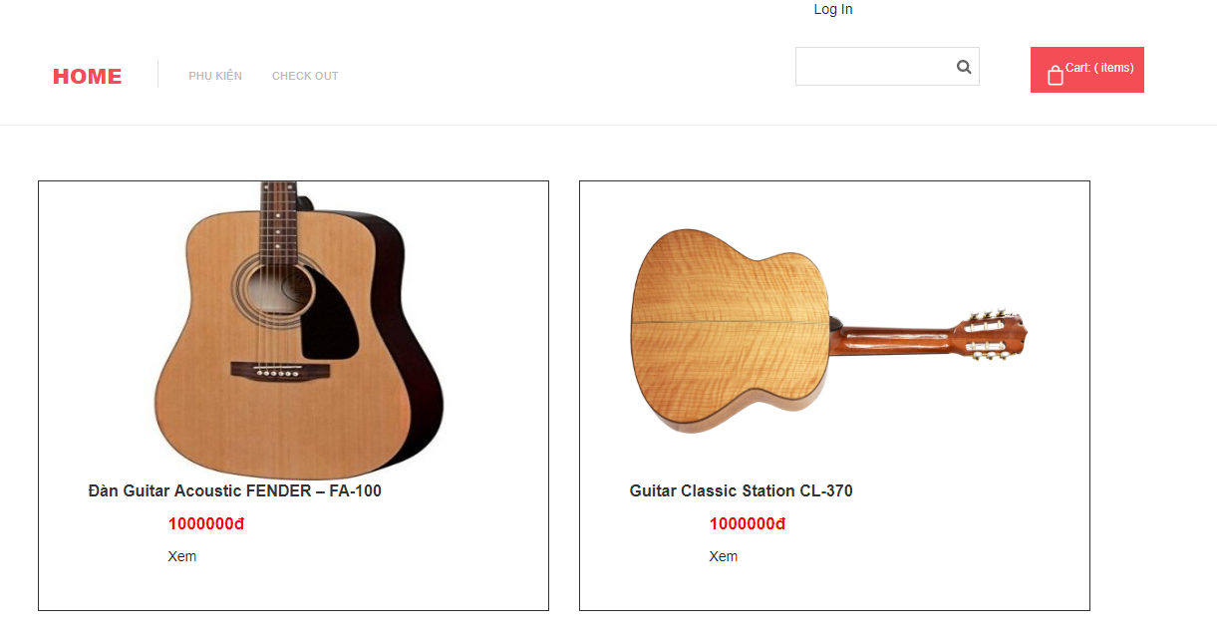
6. Demo
Sales Management Module

Slide 35

7. (Q&A)

Slide 36
Thanks for listening ^.^

